Slide 1
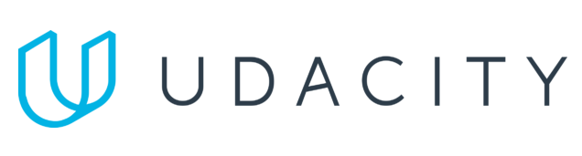
Data Lake Value Proposition
Medical Data Processing Company
Mateus Leao, Data Engineer
Udacity IPS Version 1.0

Slide 2
Agenda
What is a Data Lake
Components of a Data Lake
Data Lake vs Data Warehouse
Business Value of Data Lake Solution
Proposed Data Lake Architecture for Medical Data Processing system
Udacity IPS Ver. 1 2/2020

Slide 3
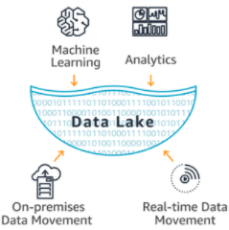
What is a Data Lake
Executive summary
A Data Lake works as a central repository for data.
It Stores Data as files and make this data easily
available for different use cases.
A Data Lake is Capable of handling Petabytes of Data
Easily Scalable and fault-tolerant.
Cost-Efficient.

Slide 4




Technology Stack – Open Source and AWS
Ingesting Solution:
Processing Solution:
Storage Solution:
Metadata/Transactionality Solution:

Slide 5
Components of a Data Lake
Ingestion Layer:
- Responsible for loading the Data into the Data Lake (staging) in the same format as they come from any data sources.
Storage Layer:
- Responsible for storing and persisting the data that the company has in a safe place. The usual tools are HDFS/S3/Google Clous Storage, etc. For this project we opted to use S3 to decouple storage from processing.
Processing Layer:
- Responsible for processing the raw data from the staging area, applying business and technical rules, and for loading the results into a separated storage area.
Serving Layer:
- It is through the serving layer that the users and applications can actually interact and consume the data.

Slide 6
Data Lake vs Data Warehouse
< Think about: Research if a Data Warehouse can still be a viable solution instead of a Data Lake? What is the difference between both? >
Please provide at least 3 items for each. No need to add any content on this slide >
< Video tip: While presenting the differences, elaborate why a Data Lake solution makes more sense for Medical Data Processing Company over a Data Warehouse approach? How the Data Lake / Big Data characteristics different from Data warehouse>

Slide 7
Data Warehouse
Data Lake
Supports only structured and semi-structured data
Data is stored in a database server or cluster.
Not optimized for updates
Storage is more expensive than data lake with S3
Supports structured, semi-structured, and unstructured data
Data is stored in the format of files (.parquet, .avro, .csv, .txt, etc)
Handle updates well with hudi/delta lake
S3 Storage is very cheap
Udacity IPS Ver. 1 2/2020

Slide 8
Business Value of Data Lake
Having a Data Lake gives a company the ability to benefit from having all of their data together ready for analytics and consumption.
Gives a company the ability to have all of its own data centralized in a single place with easy ways to access it.
Gives a company the ability of benefiting from economies of scale when using a cloud provider, while decoupling processing and storage in a very cost-efficient way, saving money to the company who builds it.

Slide 9
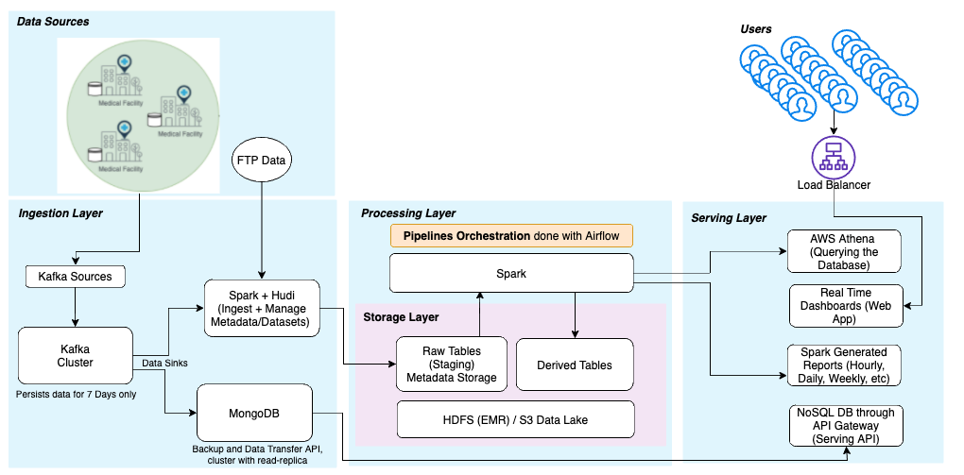
Data Lake Architecture Diagram

Slide 10
THANK YOU
Udacity IPS Version 1.0

